Slide 1
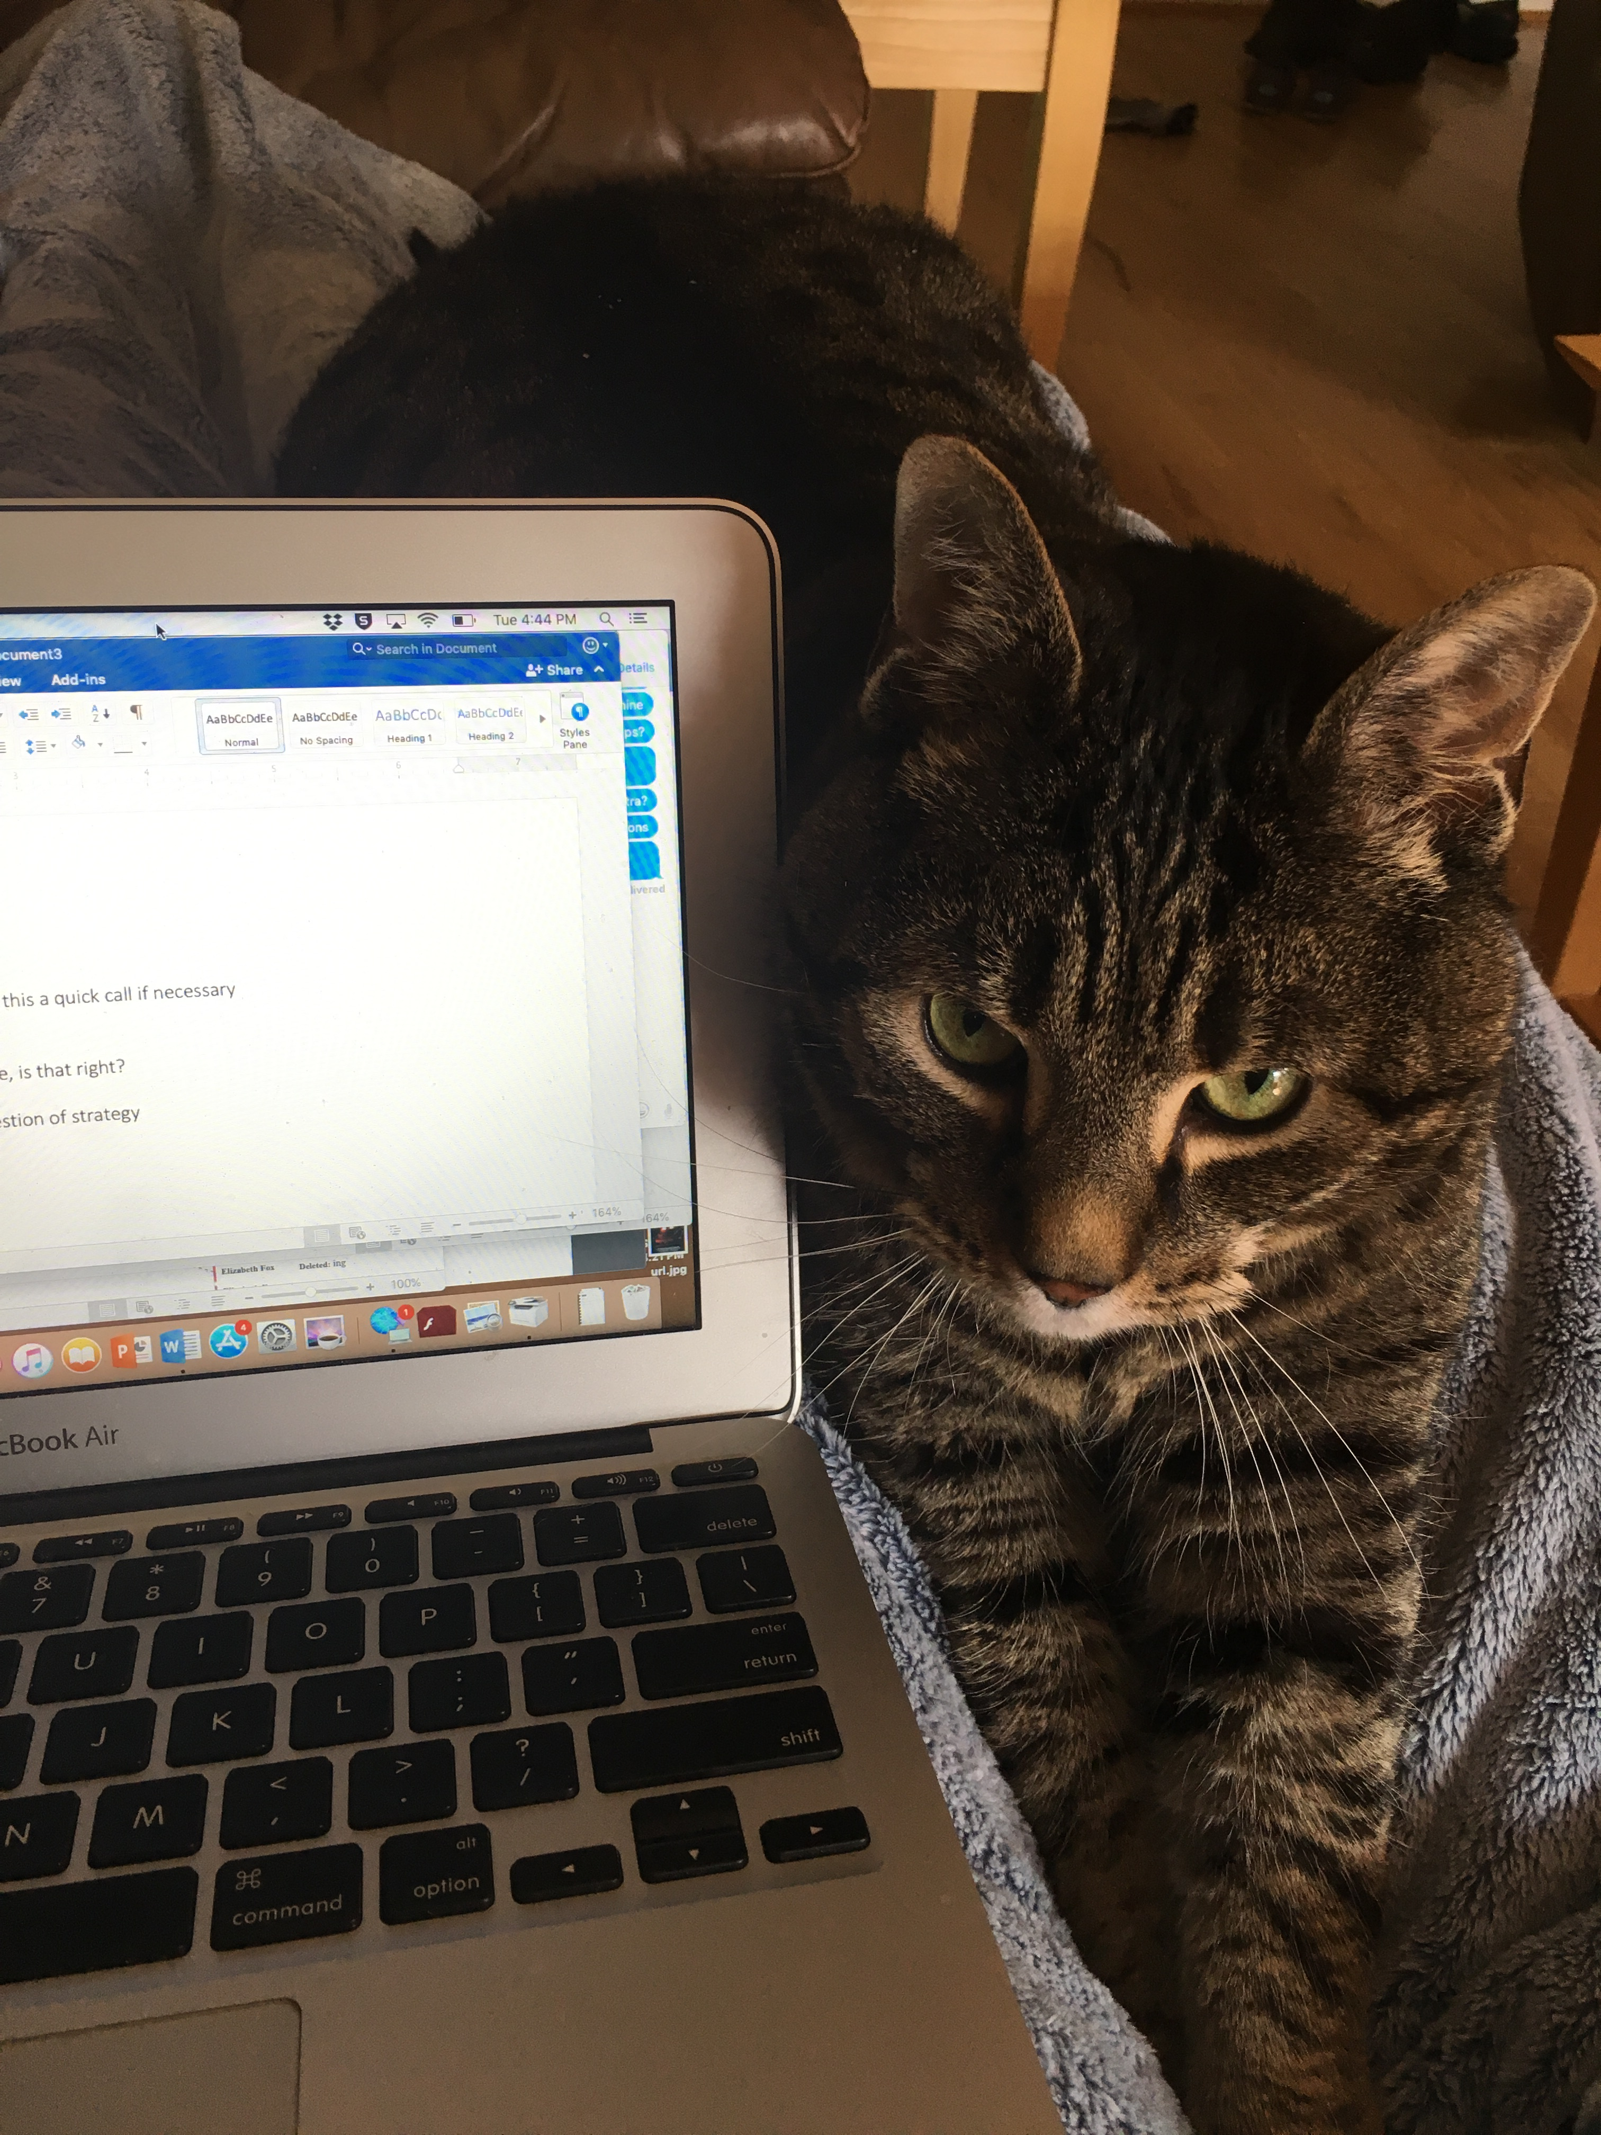
Day Two Review – HILT 2019
Notes:
short-hair / long-hair
i'm sleepy

Slide 2
Python
Why Python? Why not?
What’s the difference between a list and a dictionary?
How do you step over a collection?
How do you print something to the console?

Slide 3
Python
How do you run a command-line program?
What is a method?
What is a parameter?
What is a conditional statement?
What was the hardest thing you did yesterday?
What was the easiest?

Slide 4
Plan
Keep going!
But we take requests!
Let us know things you want us to talk about

Slide 5
Plan Cont.
Today:
Finish out concepts II.
Hand wave at concepts III.
Debugging exercises
Start working through a case study live together.

Slide 6
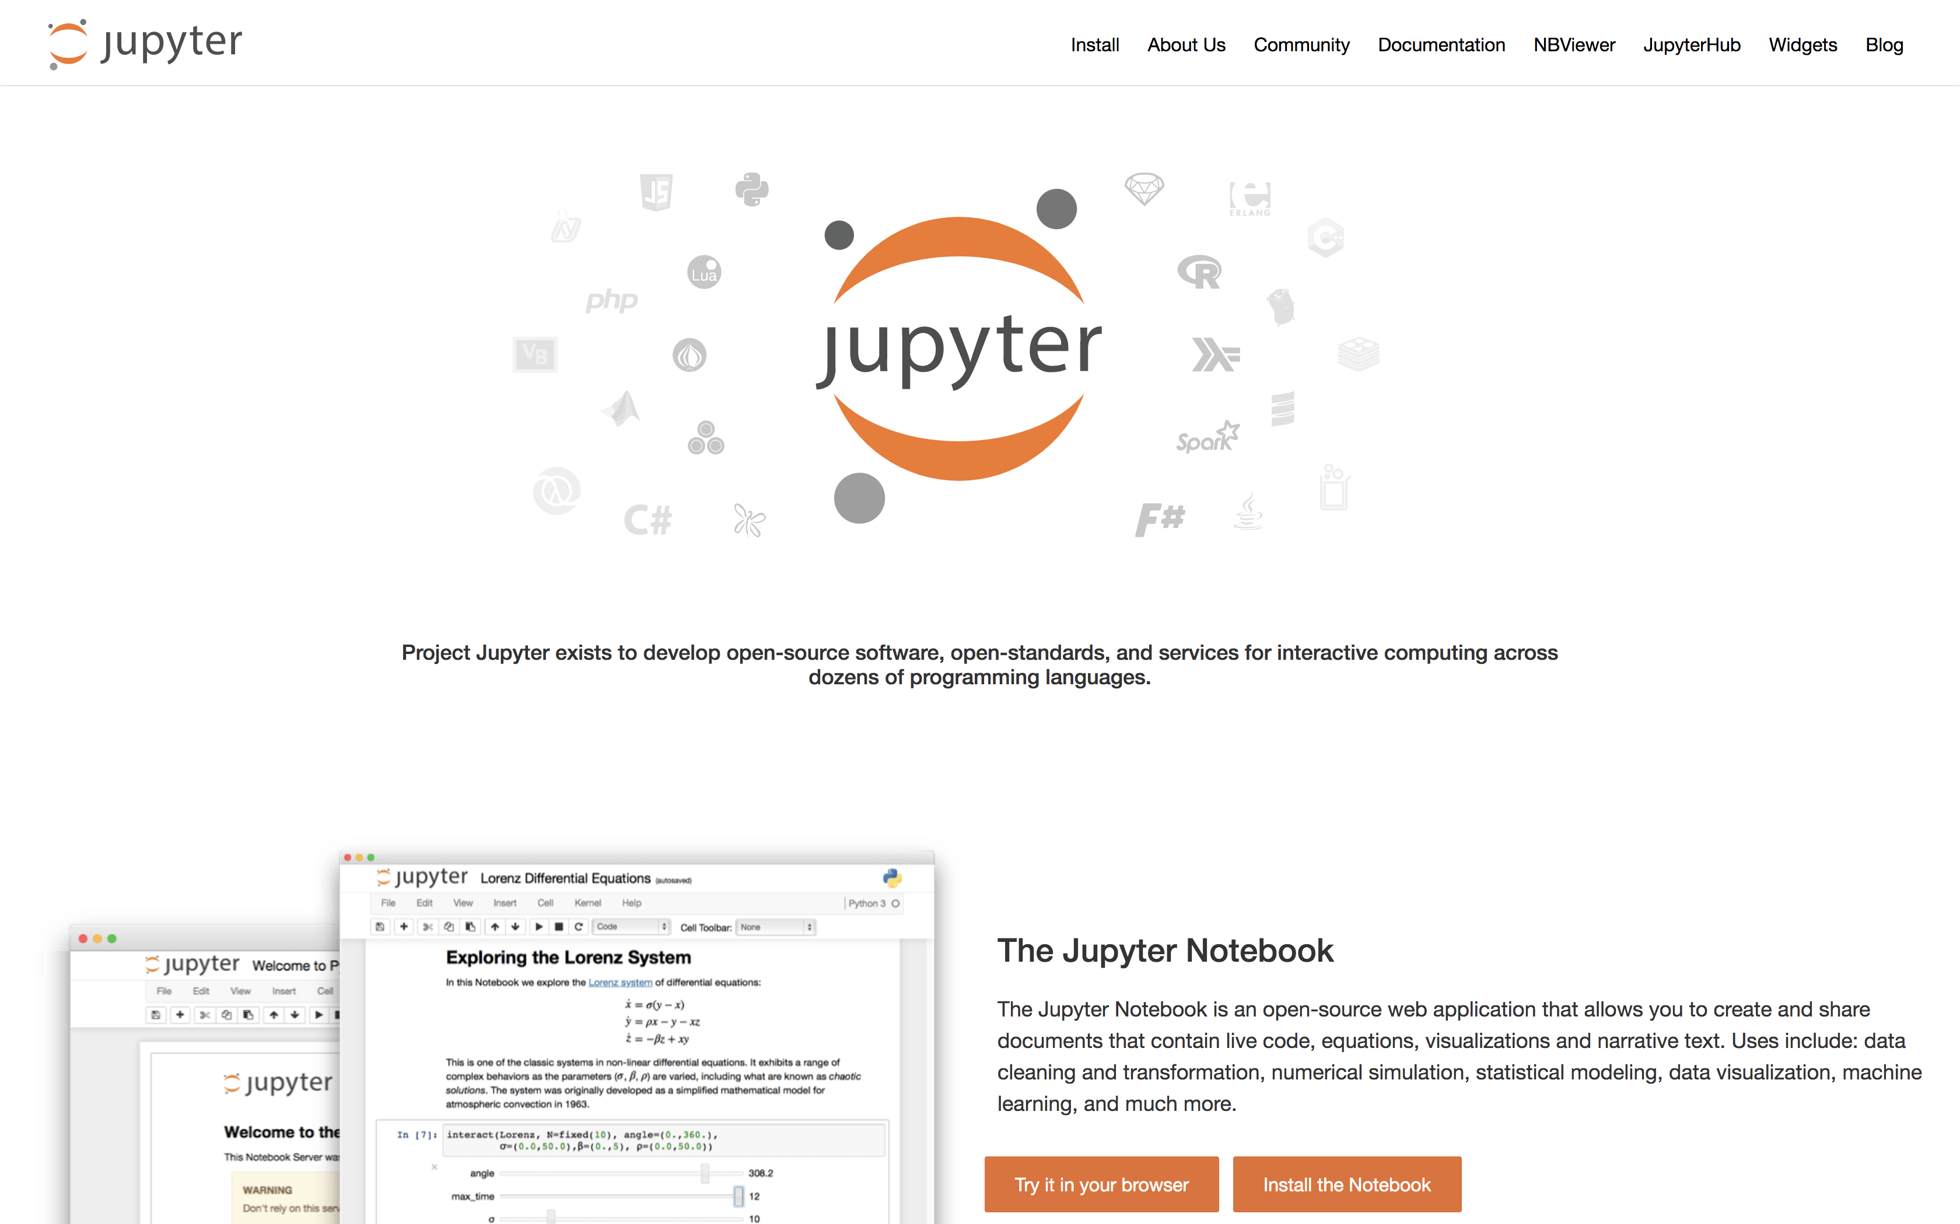
Case Studies

Slide 7
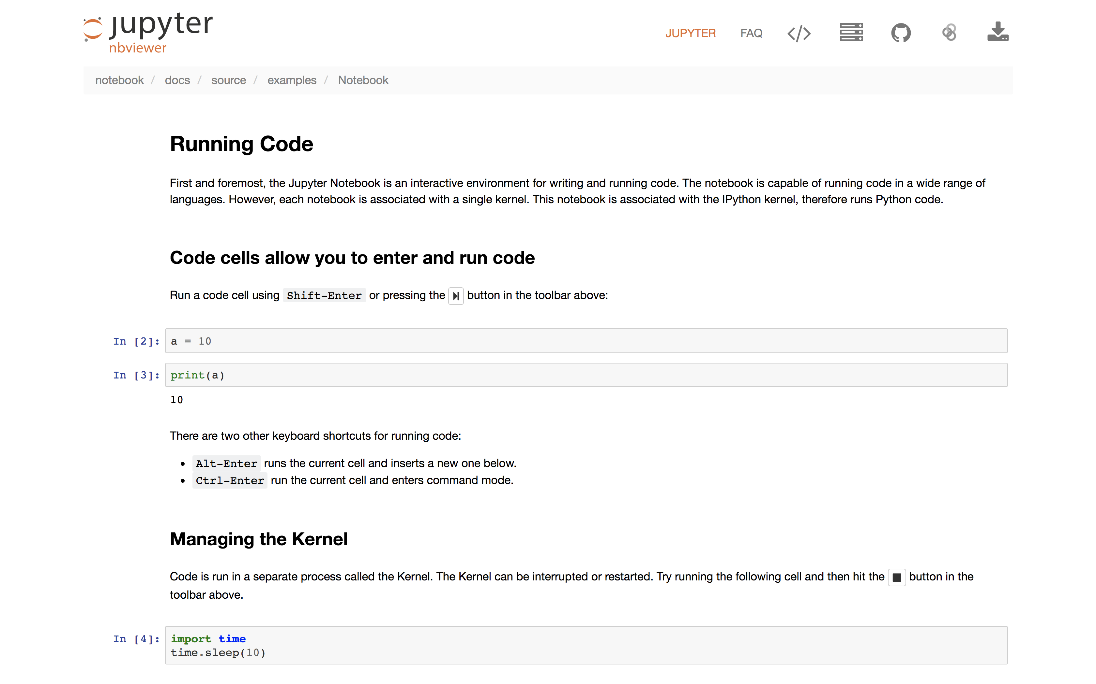
Jupyter Notesbooks Cont.

Slide 8
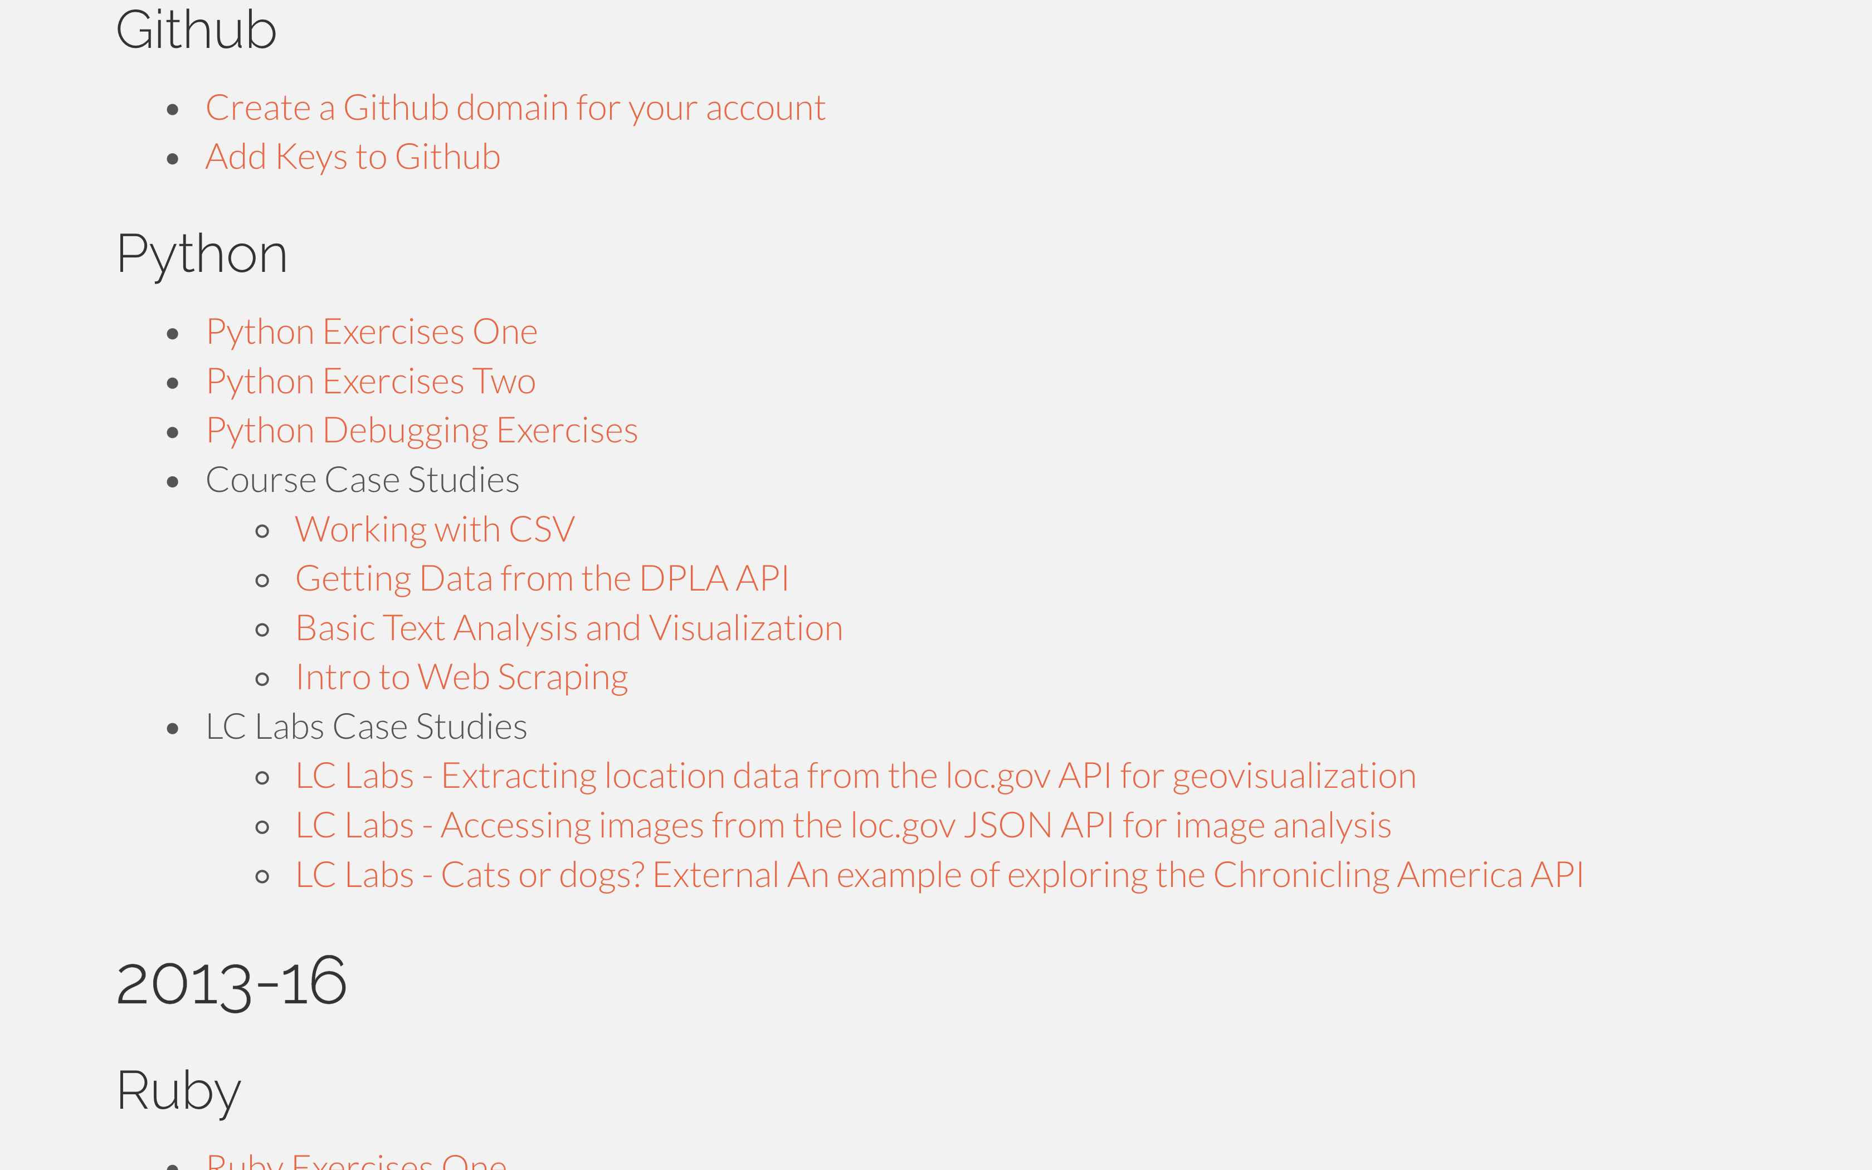
Transitioning to Independent Work
In the real world, you're often working from examples.
This is an opportunity to try that with some support!
Pick one relevant to your interests. If you have an idea for a project that you'd rather work on we can help you get started on that too.

Slide 9
Plan Cont.
All slides (incl. Concepts III) on the website.
Also have some exercises up there.
Reinforcement is important!

Slide 10
Show and Tell
Start thinking about it...

